Slide 1

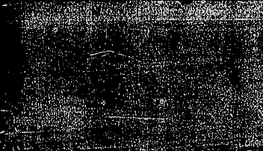
Price Surge Forecasting - Market Volatility Analysis

Slide 2
The global market is becoming increasingly volatile due to economic policies, trade regulations, and supply chain disruptions. Price swings brought on by tariffs, trade restrictions, and supply chain interruptions present serious challenges for companies, decision-makers, and consumers in the modern global economy. Unpredictable price increases affect financial planning, procurement strategies, and overall market stability. Data-driven forecasting models are essential for organizations to anticipate these variations and mitigate associated risks.

Slide 3
DATA COLLECTION AND SOURCES This research leverages comprehensive datasets collected from authoritative government sources: • United States Department Of Agriculture (USDA): agricultural price data, import/export statistics, and commodity market information • Bureau Of Labor Statistics (BLS): producer price index (PPI), consumer price index (CPI), and other inflation metrics • Federal Reserve Economic Data (FRED): economic indicators and market performance metrics

Slide 4
Methods used SMA :Simple Moving Average EMA: Exponential Moving Average EWMA: Exponential Weighted Moving Average WHY: Moving averages are statistical techniques used in time series analysis to smooth fluctuations and identify trends

Slide 5
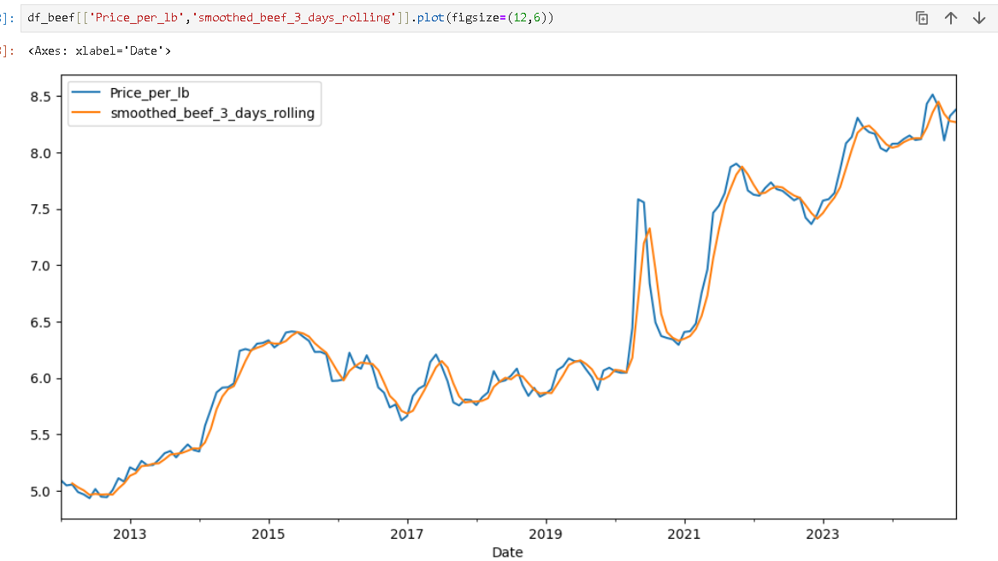

Slide 6
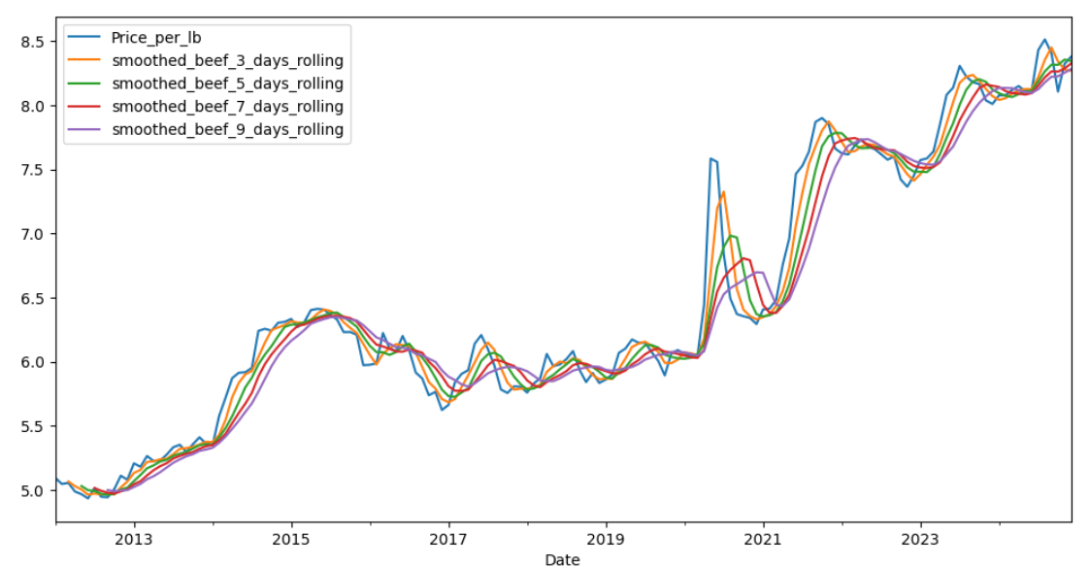

Slide 7
Why Don’t We Use SMA(Simple Moving Average)
The main disadvantage of SMA is it gives importance to all the data when we select the window size.
but in the Time series Data the main focus should be on the recent data, the most recent data should be given more importance. based on that we will do the predictions.
To overcome this we go for CMA: Cumulative Moving average

Slide 8
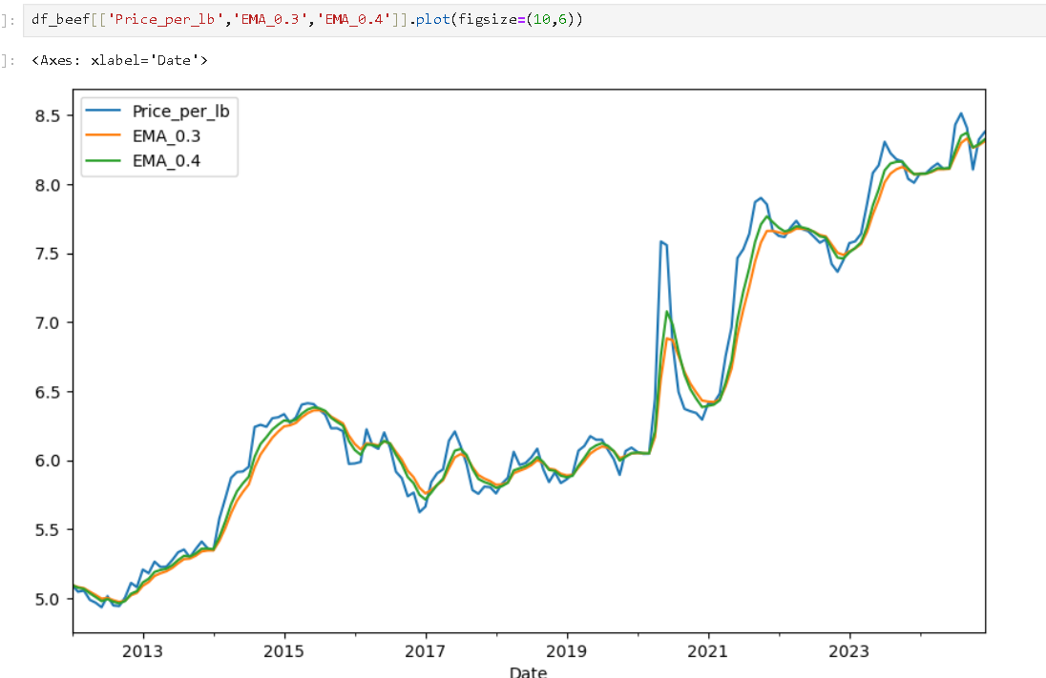
EMA(Exponential Moving Average)
The Exponential Moving Average (EMA) is a type of moving average that gives more weight to recent data points, making it more responsive to price changes than the Simple Moving Average (SMA).

Slide 9
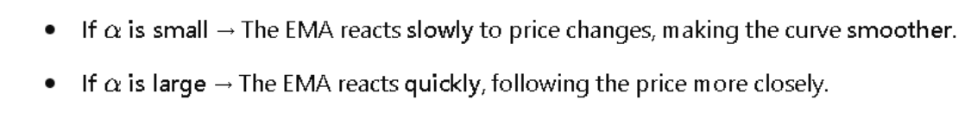
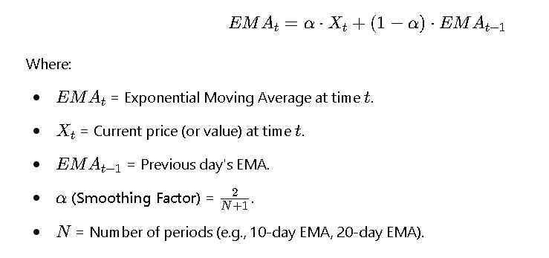
Smoothing factor
Both EMA (exponential moving average) and EWMA (exponentially weighted moving average) are used in time series analysis to smooth data, identify trends, and reduce noise.
While they may seem similar, EWMA is more generalized form of EMA that allows custom decay rates for past observations.

Slide 10
WHY ARIMA?
EMA (Exponential Moving Average) and EWMA (Exponentially Weighted Moving Average) are smoothing techniques used to filter out noise and identify trends in time series data.
They assign more weight to recent observations and are not predictive models by themselves but can be used as features in forecasting models.
ARIMA is a statistical forecasting model that combines autoregression (AR), differencing (I), and moving average (MA) components to predict future values in a time series.
It is a predictive model based on past observations.

Slide 11
Components Of ARIMA?
AR (AutoRegressive) – Uses past values to predict future values.
I (Integrated) – Differencing is applied to make the data stationary.
MA (Moving Average) – Uses past forecast errors to improve predictions.

Slide 12
What next?
Grouping products and classifying them
Forecasting the categorized section to the MLP model and forecasting the future process based on the tariff announcement and Tariff percentage.
Implementing LSTM(Long Short-Term Memory)
Both LSTM (Long Short-Term Memory) and ARIMA (AutoRegressive Integrated Moving Average) are used for time series forecasting.

Slide 13
Limitations of ARIMAX: Primarily designed for linear relationships. Struggles with complex, non-linear patterns. Does not inherently handle seasonality.
More complex than ARIMA.
Requires careful parameter tuning.
Relies on linear relationships between the exogenous variables, and the dependent variable.

Slide 14
What Is MLP?
MLP is a type of artificial neural network (ANN) that can learn complex, non-linear relationships in data.
In time series forecasting, an MLP can be trained to recognize patterns in past data and predict future values.
MLP Forecasting involves using a Multilayer Perceptron model to predict future values of a time series by converting it into a supervised learning problem. It is a powerful tool for capturing complex patterns in data, especially when combined with proper feature engineering and preprocessing.
It is able to learn very complex non linear relationships.

Slide 15
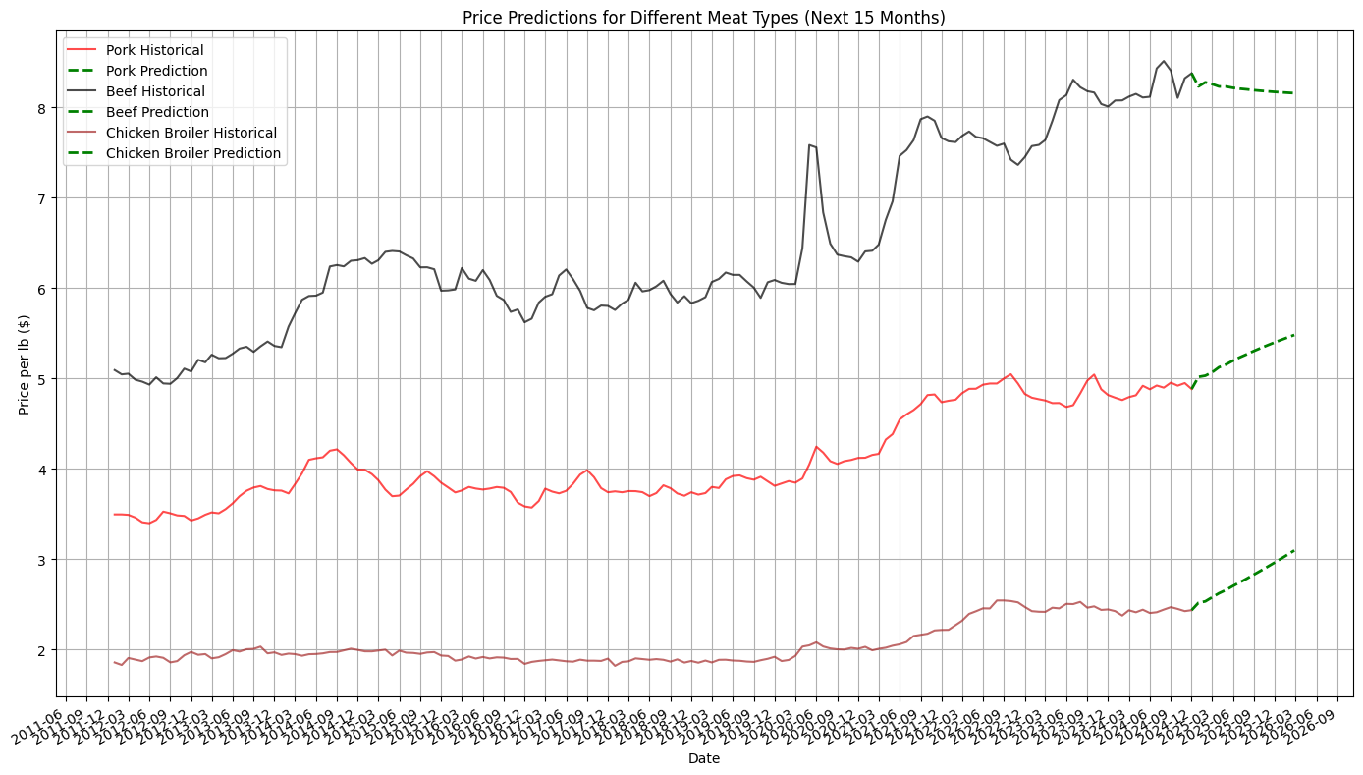

Slide 16
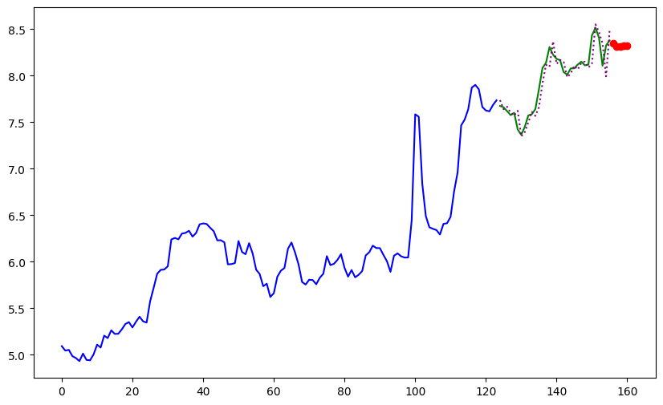

Slide 17
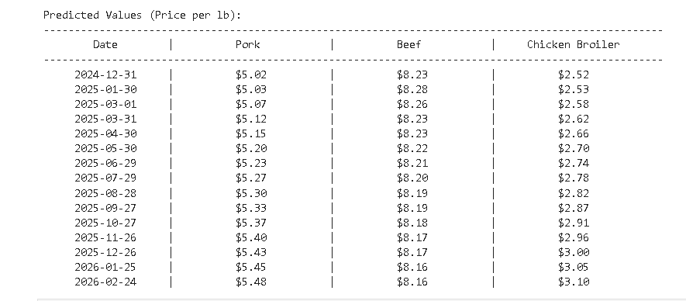
predictions

Slide 18
Why MLP Is Good For This?
It can handle complex patterns, like when multiple things affect prices together.
It doesn’t need rules written by humans it learns the rules on its own
It works well when you have lots of past data.

Slide 19
What next?
Need to implement the ARIMA and SARIMAX to check the predictions and the model performance.
scraping the price indexes data for the most recent price values.
To get the accurate prediction, need more data

